Slide 1
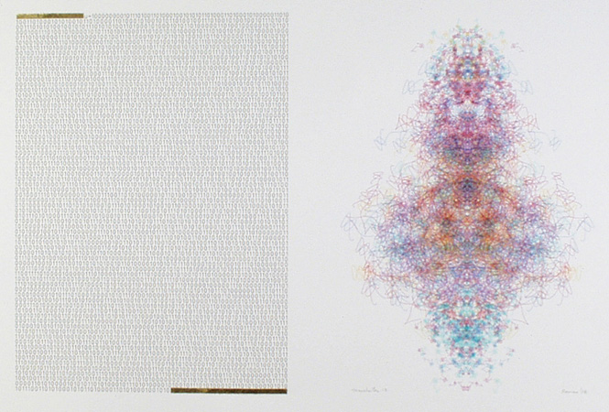

Class 31:
Universal Turing Machines
CS200: Computer Science
University of Virginia
Computer Science
David Evans
http://www.cs.virginia.edu/evans

Slide 2
Menu
Review: Modeling Computation
Universal Turing Machines
Lambda Calculus

Slide 3
Describing Turing Machines
z
z
z
z
z
z
z
z
z
z
z
z
z
z
z
z
z
z
z
z
z
z
TuringMachine ::= < Alphabet, Tape, FSM >
Alphabet ::= { Symbol* }
Tape ::= < LeftSide, Current, RightSide >
OneSquare ::= Symbol | #
Current ::= OneSquare
LeftSide ::= [ Square* ]
RightSide ::= [ Square* ]
Everything to left of LeftSide is #.
Everything to right of RightSide is #.
¬), #, R
), X, L
2: look for (
¬(, #, L
1
Start
(, X, R
HALT
#, 1, -
#, 0, -
Finite State Machine

Slide 4
Describing Finite State Machines
¬), #, R
), X, L
¬(, #, L
1
2: look for (
Start
(, X, R
HALT
#, 1, #
#, 0, #
TuringMachine ::= < Alphabet, Tape, FSM >
FSM ::= < States, TransitionRules, InitialState, HaltingStates >
States ::= { StateName* }
InitialState ::= StateName must be element of States
HaltingStates ::= { StateName* } all must be elements of States
TransitionRules ::= { TransitionRule* }
TransitionRule ::=
< StateName, ;; Current State
OneSquare, ;; Current square
StateName, ;; Next State
OneSquare, ;; Write on tape
Direction > ;; Move tape
Direction ::= L, R, #
Transition Rule is a procedure:
StateName X OneSquare
→ StateName X OneSquare X Direction

Slide 5
Enumerating Turing Machines
Now that we’ve decided how to describe Turing Machines, we can number them
TM-5023582376 = balancing parens
TM-57239683 = even number of 1s
TM-3523796834721038296738259873 = Photomosaic Program
TM-3672349872381692309875823987609823712347823 = WindowsXP
Not the real numbers – they would be much bigger!

Slide 6
Universal Turing Machines

Slide 7
Universal Turing Machine
P Number
of TM
Universal
Turing
Machine
Output
Tape
for running
TM-P
in tape I
I
Input
Tape
Can we make a Universal Turing Machine?
also, just a number!

Slide 8
Yes!
People have designed Universal Turing Machines with
  4 symbols, 7 states (Marvin Minsky)
  4 symbols, 5 states
  2 symbols, 22 states
  18 symbols, 2 states
No one knows what the smallest possible UTM is

Slide 9
Manchester Illuminated Universal Turing Machine, #9
from http://www.verostko.com/manchester/manchester.html

Slide 10
Church-Turing Thesis
Any mechanical computation can be performed by a Turing Machine
There is a TM-n corresponding to every decidable problem
We can simulate one step on any “normal” (classical mechanics) computer with a constant number of steps on a TM:
  If a problem is in P on a TM, it is in P on an iMac, CM5, Cray, Palm, etc.
  But maybe not a quantum computer!

Slide 11
Universal Language
Is Scheme as powerful as a Universal Turing Machine?
Is a Universal Turing Machine as powerful as Scheme?

Slide 12
Complexity in Scheme
Special Forms
  if, cond, define, etc.
Primitives
  Numbers (infinitely many)
  Booleans: #t, #f
  Functions (+, -, and, or, etc.)
Evaluation Complexity
  Environments (more than ½ of our meval code)
If we have lazy evaluation and don’t care about abstraction, we don’t need these.
Hard to get rid of?
Can we get rid of all this and still have a useful language?

Slide 13
λ-calculus
Alonzo Church, 1940
(LISP was developed from λ-calculus, not the other way round.)
    term = variable
    | term term
    | (term)
    | λ variable . term

Slide 14
What is Calculus?
In High School:
  d/dx x^{n} = nx^{n-1} [Power Rule]
  d/dx (f + g) = d/dx f + d/dx g [Sum Rule]
Calculus is a branch of mathematics that deals with limits and the differentiation and integration of functions of one or more variables...

Slide 15
Real Definition
A calculus is just a bunch of rules for manipulating symbols.
People can give meaning to those symbols, but that’s not part of the calculus.
Differential calculus is a bunch of rules for manipulating symbols. There is an interpretation of those symbols corresponds with physics, slopes, etc.

Slide 16
Lambda Calculus
Rules for manipulating strings of symbols in the language:
term = variable
    | term term
    | (term)
    | λ variable . term
Humans can give meaning to those symbols in a way that corresponds to computations.

Slide 17
Why?
Once we have precise and formal rules for manipulating symbols, we can use it to reason with.
Since we can interpret the symbols as representing computations, we can use it to reason about programs.

Slide 18

Evaluation Rules
  α-reduction (renaming)
  λy. M ⇒_{α} λv. (M [y v])
  where v does not occur in M.
  β-reduction (substitution)
  (λx. M)N ⇒ _{β} M [ x N ]

Slide 19
Reduction (Uninteresting Rules)
  λy. M → λv. (M [y v])
  where v does not occur in M.
  M → M
  M → N ⇒ PM → PN
  M → N ⇒ MP → NP
  M → N ⇒ λx. M → λx. N
  M → N and N → P ⇒ M → P

Slide 20
β-Reduction
(the source of all computation)
  (λx. M)N → M [ x N ]

Slide 21
Evaluating Lambda Expressions
redex: Term of the form (λx. M)N
Something that can be β-reduced
An expression is in normal form if it contains no redexes (redices).
To evaluate a lambda expression, keep doing reductions until you get to normal form.

Slide 22
Recall Apply in Scheme
“To apply a procedure to a list of arguments, evaluate the procedure in a new environment that binds the formal parameters of the procedure to the arguments it is applied to.”
We’ve replaced environments with substitution.
We’ve replaced eval with reduction.

Slide 23
Some Simple Functions
I ≡ λx.x
C ≡ λxy.yx
Abbreviation for λx.(λy. yx)
CII = (λx.(λy. yx)) (λx.x) (λx.x)
→_{β} (λy. y (λx.x)) (λx.x)
→_{β} λx.x (λx.x)
→_{β} λx.x
= I

Slide 24
Example
λ f. ((λ x.f (xx)) (λ x. f (xx)))
…we’ll work on this Wednesday

Slide 25
Charge
PS7 Due Wednesday (2:00)
PS8 Team Requests Due Wednesday (11:59pm)
  If you don’t make a team request, you will be assigned randomly into a team
Wednesday: show Lambda calculus is equivalent to a Turing Machine

